Slide 1


FAKE DOCUMENT DETECTION
Carried Out By
R.Indhumathi
R.Sakthivel
M.Sudhakar
P.Mukilarasan
Guided By
Dr.S.Vijayalakshmi,
Head Of The Department Professor,
Department Of Information Technology,
Park College Of Engineering & Technology.

Slide 2
ABSTRACT
The forgery of official documents becomes familiar and this made a lot of problems and difficulties to the official institutions .
The current document detection is not so efficient, so some people make fake document and do illegal activities.
The proposed system is used to detect the fake documents .The application that we are developed using java programming under image processing techniques is used to detect the fake education document.
In this proposed project, the originality of document is discussed and focused on making the detection of forgery document more robust and reliable.

Slide 3
INTRODUCTION
Many people use this way illegally to get jobs throw out forgery their certificate.
Formally, many technologies were less effective in countering the danger of faking identity documents.
New methods must be improved to restrict that threat .
The proposed system uses the image processing techniques to detect the forgery document from original .

Slide 4
EXISTING SYSTEM
The existing system algorithms and the techniques used were complex and difficult to understand and results were not much accurate and consistent and also there were security issues generated while storing the documents.
This system only used for the document verification, so the document forgery cannot be detected by this system .
Deep learning algorithm is difficult to understand and implementation.
Disadvantages
Less data security
Load on single server
Less efficiency in retrieval and storage of data
Results are not accurate that is not 100 percent perfect

Slide 5
PROPOSED SYSTEM
The proposed system uses the image processing technique to detect the fake document ,firstly the QR-code of the document has been used for detecting the fraud documents .
If the document is original means the QR- code in that document gives the encrypted code of the documents.
In case, if the document is duplicate means , our application scan the QR- code does not give any encrypted code and give alert message to the person who scan the document to notify that the document is fake.
ADVANTAGES
Minor errors can be rectified.
Time efficient
It is Cheaper and faster
Increased accuracy up to 100%

Slide 6

APPLICATIONS
It used to detect fake documents .
It works online as well as offline .
The alert message are used to identify the fake documents .
It used in various field like education , job ,government etc.., to identify the fake documents

Slide 7

SYSTEM REQUIREMENTS
Hardware Requirements
Processor : Intel processor 3.0 GHz
RAM : 2GB
Hard disk : 500 GB
Compact Disk : 650 Mb
Keyboard : Standard keyboard
Monitor : 15 inch color monitor
Software Requirements
Front End : Java
Back End : SQLite/Xml
Operating System : Windows OS
System type : 32 or 64-bit

Slide 8
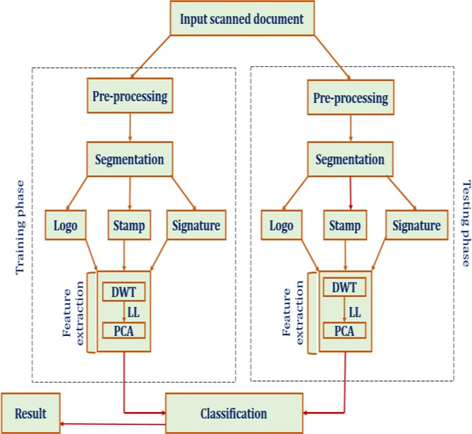
SYSTEM DESIGN
ARCHITECTURE

Slide 9
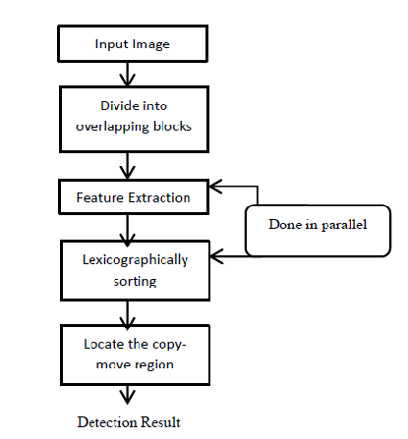
FLOW DIAGRAM

Slide 10
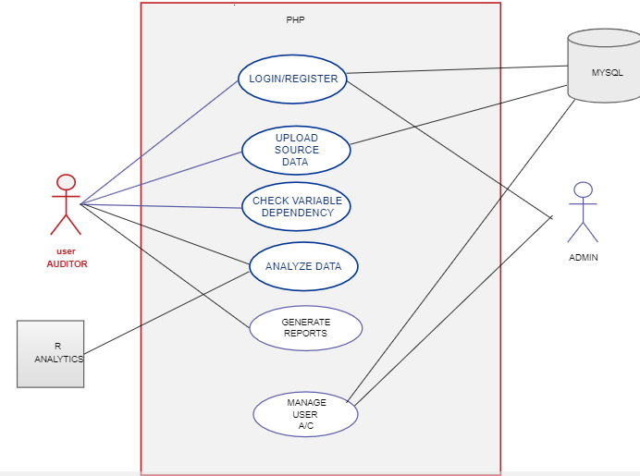
UML DIAGRAMS
USE CASE DIAGRAM

Slide 11
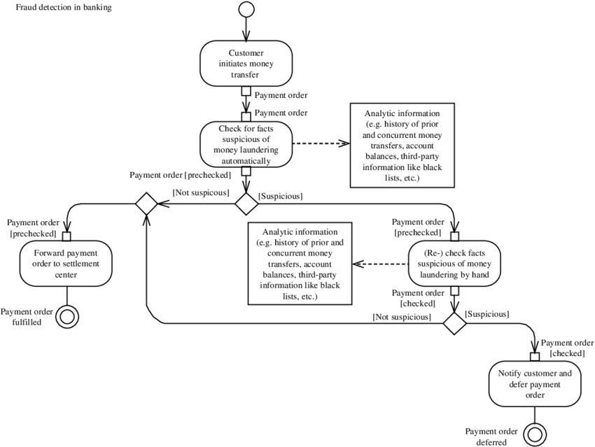
ACTIVITY DIAGRAM

Slide 12
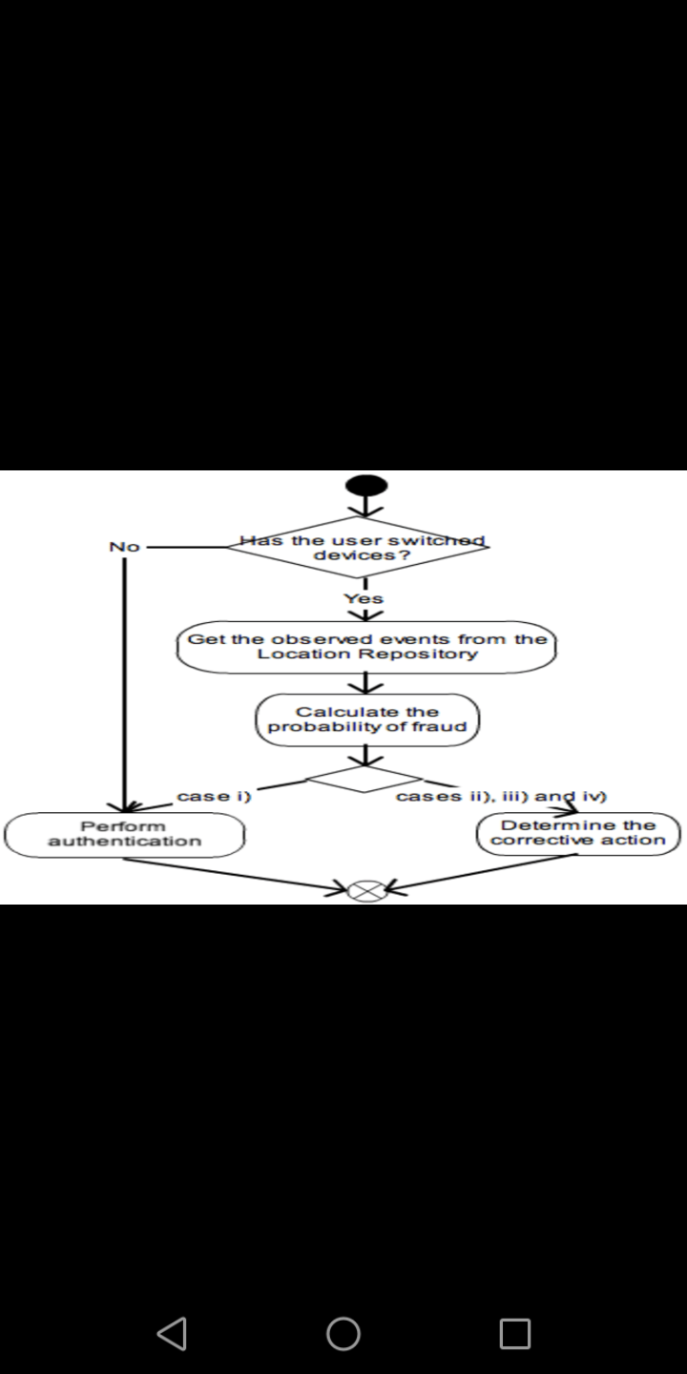
INTERACTION DIAGRAM

Slide 13
MODULES
LIST OF MODULES
Login module
Verification module
Result module

Slide 14
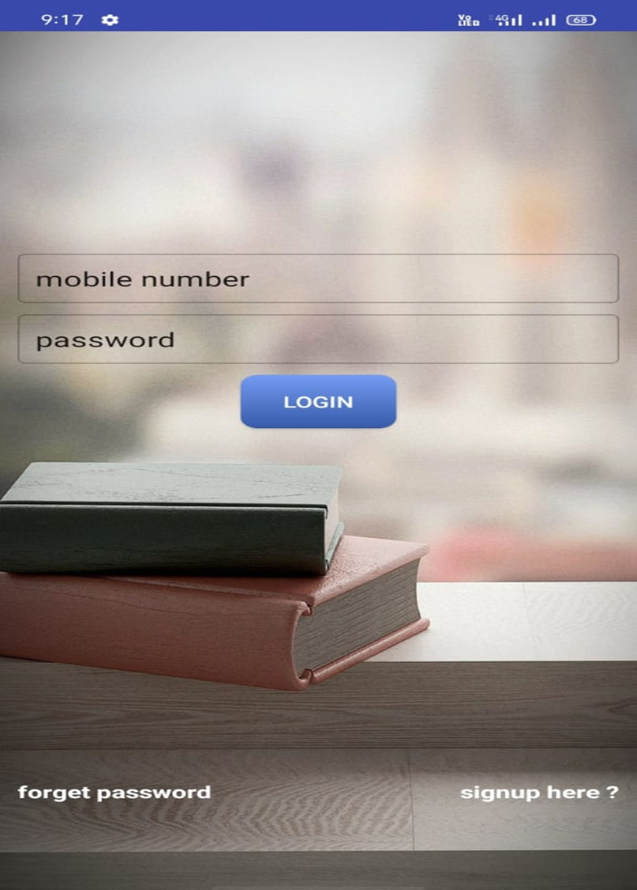
LOGIN MODULE
First the user has to login into the application with their mobile number and the password as the given mobile number.

Slide 15
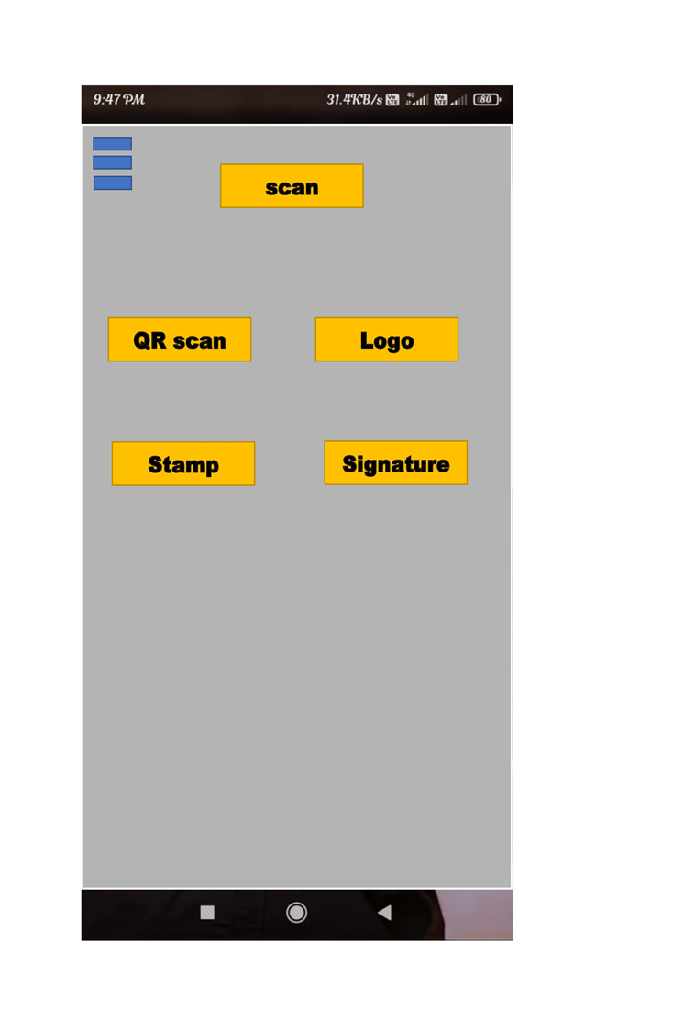
VERIFICATION MODULE
In this module , there are four sub-modules to detect the fake document, they are QR-code logo ,stamp and signature .

Slide 16
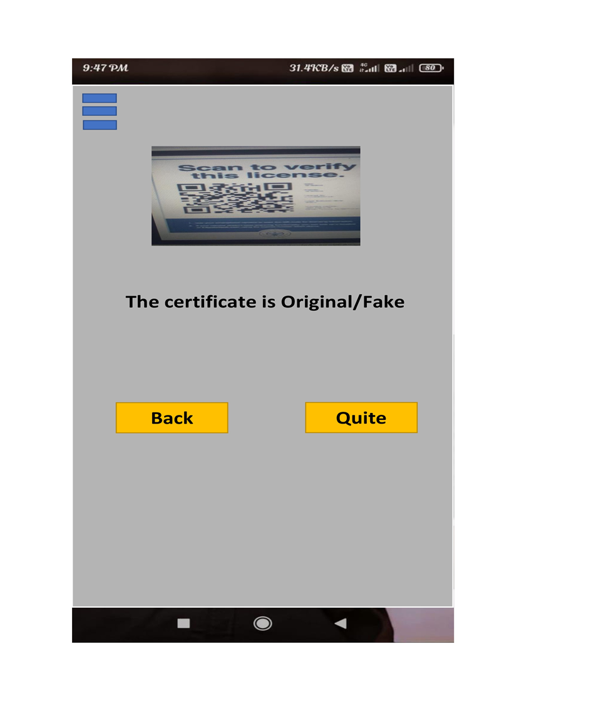
RESULT MODULE
In the result module ,the application that detect that the document is original or fake .

Slide 17
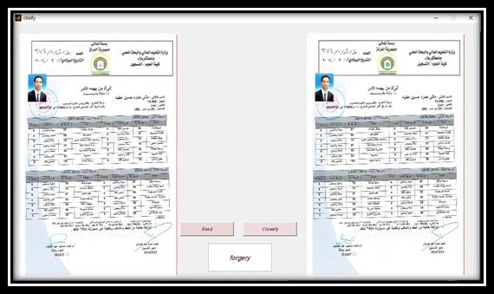
EXPECTED OUTPUT

Slide 18

CONCLUSION
Thus the program for FACK DOCUMENT DETECTION using Image processing System and deep learning has been successfully executed and codes are generated.

Slide 19
REFERENCE
[1]International Research Journal of Engineering and Technology (IRJET) MAY-2020, Shantanu Sarode , Utkarsha Khandare , Shubham Jadhav , Avinash Jannu, Vishnu Kamble, Digvijay Patil.
[2] IOP Journal of Physics: Conference Series 2019, A Kuznetsov, Samara National Research University, Moskovskoe Shosse , Image Processing Systems Institute of RAS - Branch of the FSRC "Crystallography and Photonics" RAS.
[3]International Journal of Scientific and Engineering Research · November 2018 ,Shaimaa Hameed University of Technology, Iraq International Journal of Scientific & Engineering Research.

Slide 20


